Slide 1
CREDIT CARD DEFAULT
By:
Shubham Bhatt
70271018106
M.tech Data Science

Slide 2
Credit Card Default
Credit card default happens when you've become severely delinquent on your credit card payment. It's a serious credit card status that not only affects your standing with that credit card issuer, but also your credit standing in general and your ability to get approved for credit cards, loans, and other credit-based services.

Slide 3
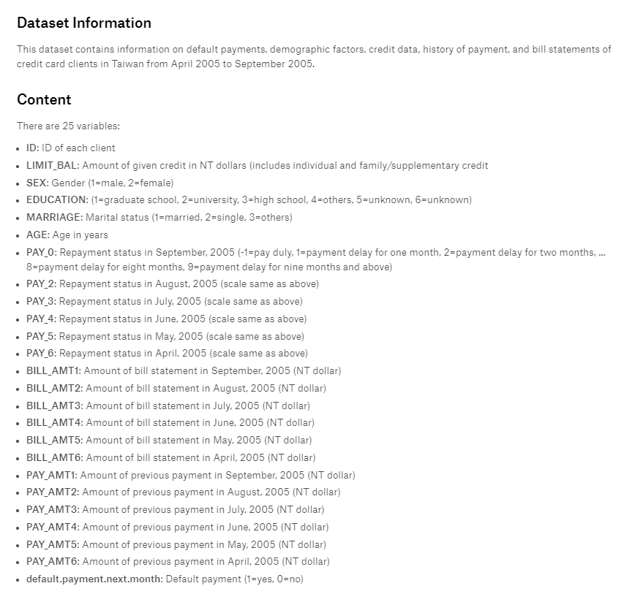

Slide 4
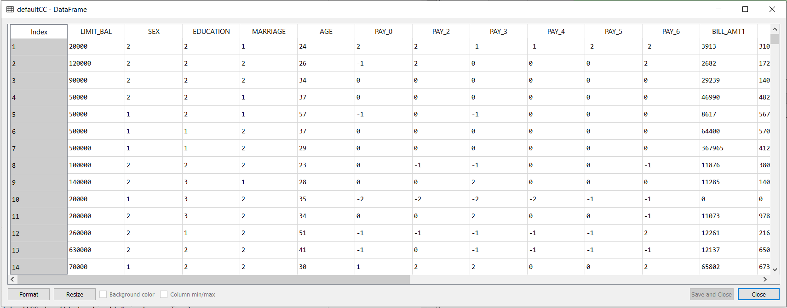
Original Data

Slide 5
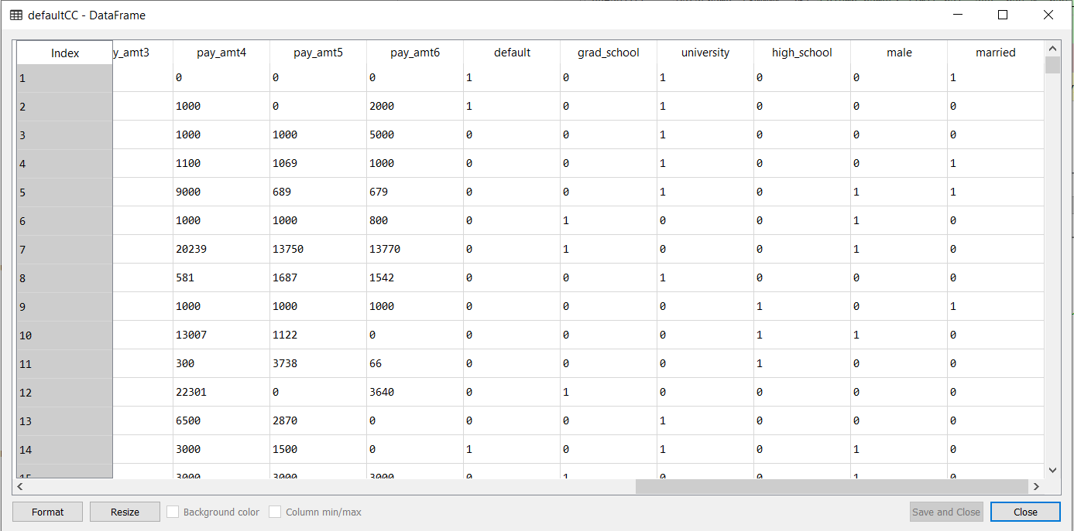
Encoded Data

Slide 6
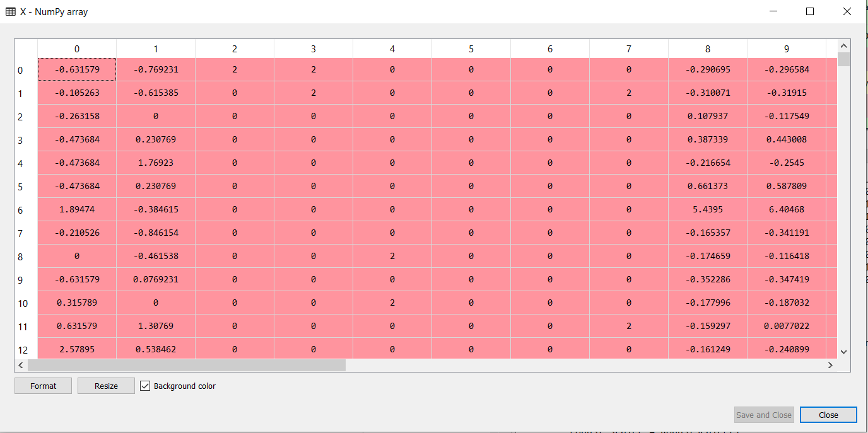
Scaled Data Using Robust Scaler

Slide 7
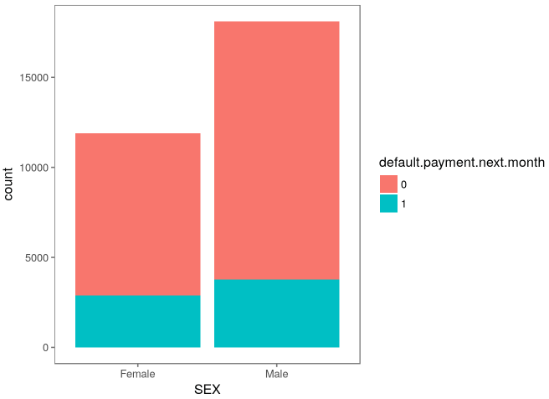
Data Visualization

Slide 8
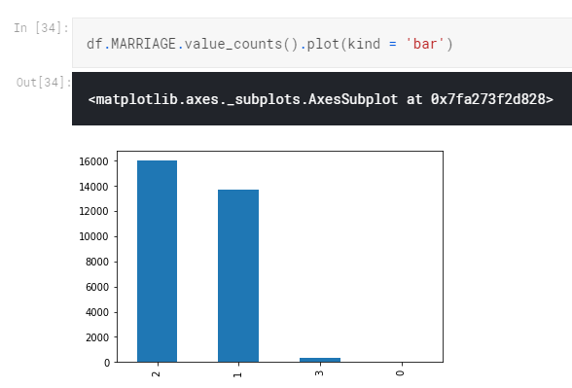

Slide 9
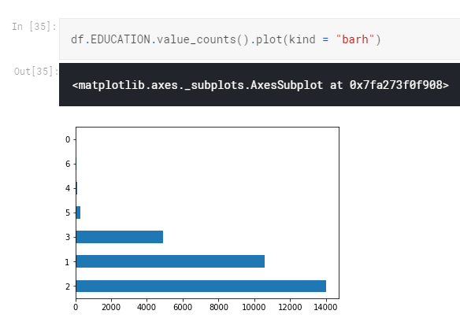

Slide 10
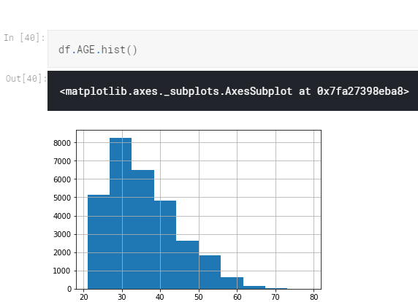

Slide 11
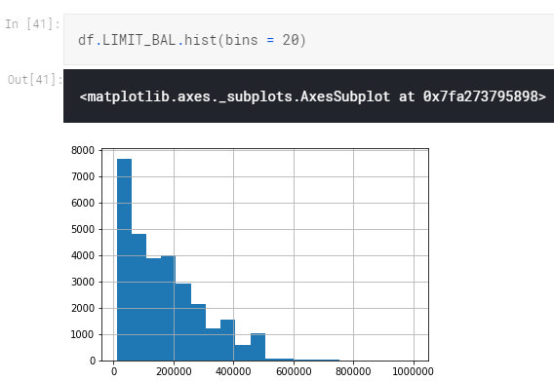

Slide 12
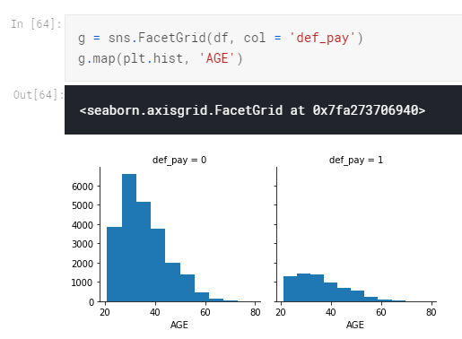

Slide 13
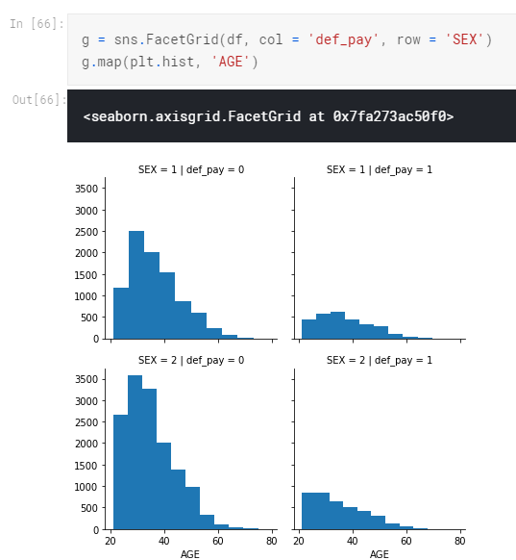

Slide 14
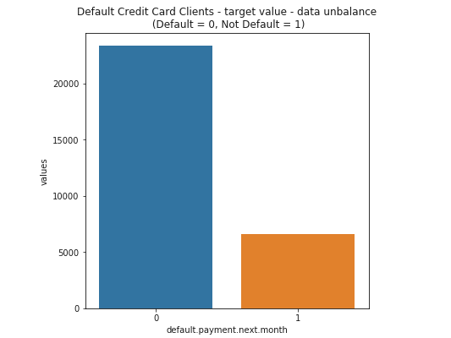

Slide 15
Thank You!

